Slide 1

C# Introduction
C# Training
Rainer Stropek
software architects
Web
Mail
Twitter
http://www.timecockpit.com
rainer@timecockpit.com
@rstropek
The C# Programming Language

Slide 2
Agenda
Program Structure
Lexical Analysis
C# Typesystem
Expressions
Statements
Classes and Objects
Structs
Arrays
Interfaces
Enumerations
Delegates
Attributes
Documentation Comments

Slide 3
Program Structure
C# Introduction

Slide 4
Program Structure
C# programs are organized into
Programs
One or more source files
Namespaces
Organize types
Types
E.g. classes, interfaces, etc.
Members
Defined in types
E.g. fields, methods, properties, events, etc.
Assemblies
Packaging unit for programs
.exe or .dll

Slide 5
Program Structure Library Sample
using System;
namespace Acme.Collections
{
public class Stack
{
Entry top;
public void Push(object data) {
top = new Entry(top, data);
}
public object Pop() {
if (top == null) throw new InvalidOperationException();
object result = top.data;
top = top.next;
return result;
}
class Entry
{
public Entry next;
public object data;
public Entry(Entry next, object data) {
this.next = next;
this.data = data;
}
}
}
}
Compile with csc /t:library acme.cs

Slide 6
Program Structure Application Sample
using System;
using Acme.Collections;
class Test
{
static void Main() {
Stack s = new Stack();
s.Push(1);
s.Push(10);
s.Push(100);
Console.WriteLine(s.Pop());
Console.WriteLine(s.Pop());
Console.WriteLine(s.Pop());
}
}
Compile with csc /r:acme.dll test.cs

Slide 7
Program Structure
Tips
Declaration order is insignificant
Using is not C‘s #include
Split type declaration by using partial classes

Slide 8
C# Lexical Analysis
C# Introduction

Slide 9
C# Lexical Analysis
Comments
Single line: // Comment
Multi line: /* Comment */
Escaping of keyword with @
E.g. class @class { […] }

Slide 10
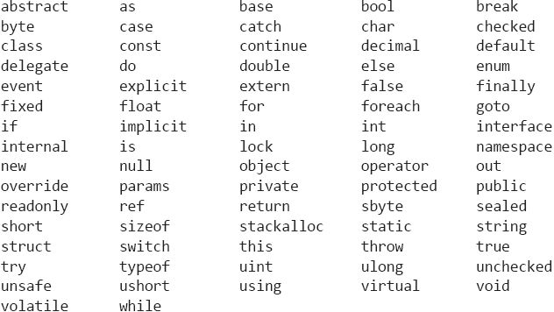
C# Lexical Analysis Keywords
http://msdn.microsoft.com/en-us/library/x53a06bb.aspx

Slide 11
C# Lexical Analysis
Character and string literals
Character literal: 'c'
String: "string"
Verbatim strings: @"string"

Slide 12
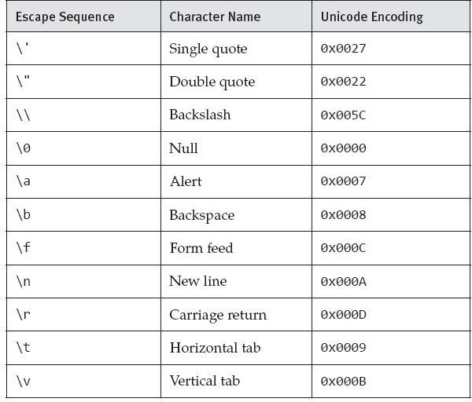
C# Lexical Analysis Escape Sequences

Slide 13
C# Lexical Analysis Preprocessor
#define and #undef
used to define and undefine, respectively, conditional compilation symbols
#if, #elif, #else, and #endif
used to conditionally skip sections of source code
#line
used to control line numbers emitted for errors and warnings
#error and #warning
used to issue errors and warnings, respectively
#region and #endregion
used to explicitly mark sections of source code
#pragma
used to specify optional contextual information to the compiler
http://msdn.microsoft.com/en-us/library/ed8yd1ha.aspx

Slide 14
C# Lexical Analysis Preprocessor
#define A
#undef B
class C
{
#if A
void F() {}
#else
void G() {}
#endif
#if B
void H() {}
#else
void I() {}
#endif
}
#warning Code review needed before check-in
#if Debug && Retail
#error A build can't be both debug and retail
#endif
class Test {...}
using System;
class Program
{
[Obsolete]
static void Foo() {}
static void Main() {
#pragma warning disable 612
Foo();
#pragma warning restore 612
}
}

Slide 15
C# Typesystem
C# Introduction

Slide 16
C# Typesystem Kinds of types
Value types
Variables directly contain their data
Reference types
Variables store references to their data (i.e. to their objects)
Two variables of a reference type can share a single object
Special types: Expression tree types (used for LINQ)
http://msdn.microsoft.com/en-us/library/ms173104.aspx

Slide 17
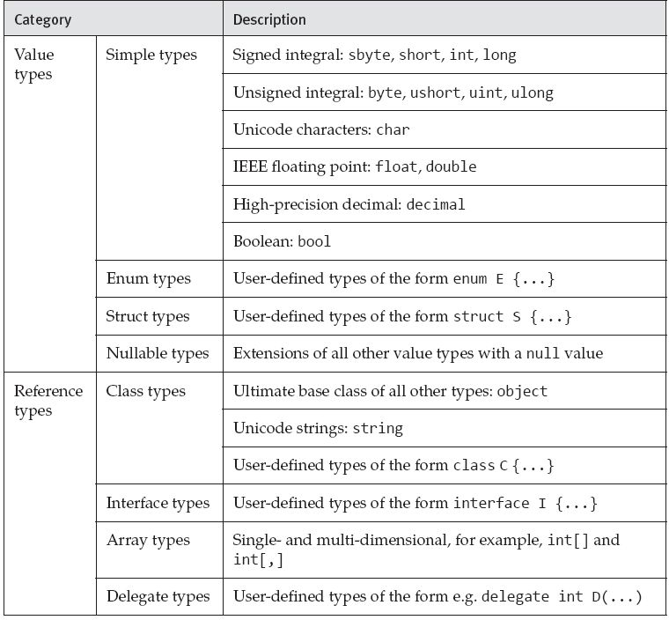
C# Typesystem Overview

Slide 18
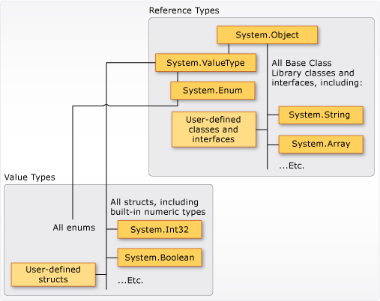
C# Typesystem Overview

Slide 19
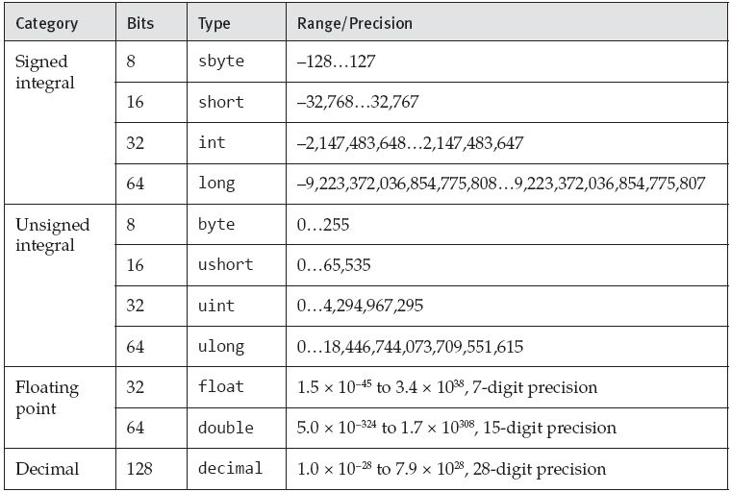
C# Typesystem Numeric Types

Slide 20
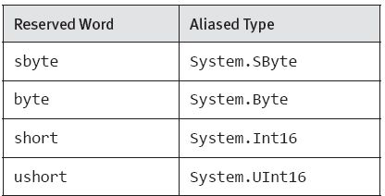
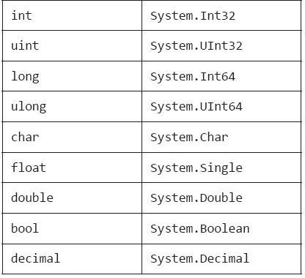
C# Typesystem Aliases of Simple Types
Tip: Every simple type has the members of its aliased type

Slide 21
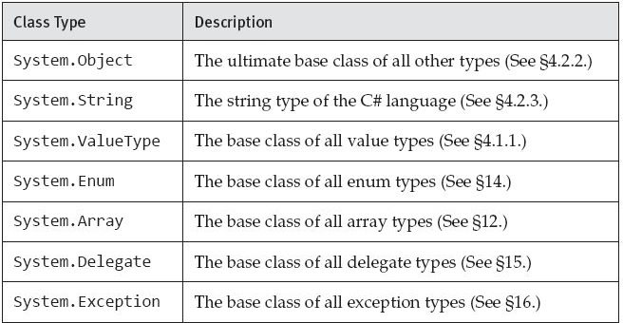
C# Typesystem Predefined Classes for Reference Types

Slide 22
C# Typesystem User Defineable Type Categories
Class types
Reference types
Struct types
Value types
Interface types
Enum types
Delegate types
Note: Single inheritance only!

Slide 23
C# Typesystem Boxing/Unboxing
Value types can become objects „on demand“
Boxing
Object instance is created „box“
Value is copied into that „box“
Unboxing
Value of „box“ is copied into value type

Slide 24
C# Typesystem Boxing/Unboxing
using System;
class Test
{
static void Main() {
int i = 123;
object o = i; // Boxing
int j = (int)o; // Unboxing
}
}

Slide 25
C# Typesystem Nullable Types
Represent all values of its underlying type plus an additional null value
Written as T? (T is the underlying type)
HasValue property
Value property
Underlying type cannot be a nullable type or a reference type

Slide 26
C# Typesystem Expression Tree Types
Permit anonymous functions to be represented as data structures instead of executable code
System.Linq.Expressions.Expression<D>

Slide 27
C# Typesystem Expression Tree Types
Func<int,int> d = x => x + 1; // Code
Expression<Func<int,int>> e = x => x + 1; // Data
Func<int,int> f = e.Compile();
// After executing this code, i1 and i2 will both have the value 2
int i1 = d(1);
int i2 = f(1);

Slide 28
C# Typesystem typeof Operator
The typeof operator is used to obtain the System.Type object for a type
To get System.Type for an instance of a type use System.Object.GetType()

Slide 29
C# Typesystem typeof Operator
using System;
class X<T>
{
public static void PrintTypes() {
Type[] t = {
typeof(int),
typeof(System.Int32),
typeof(string),
typeof(double[]),
typeof(void),
typeof(T),
typeof(X<T>),
typeof(X<X<T>>),
typeof(X<>)
};
for (int i = 0; i < t.Length; i++) {
Console.WriteLine(t[i]);
}
}
}
class Test
{
static void Main() {
X<int>.PrintTypes();
}
}

Slide 30
C# Typesystem is and as Operators
is
used to dynamically check if the runtime type of an object is compatible with a given type
as
used to explicitly convert a value to a given reference type or nullable type
Never throws an exception; if the indicated conversion is not possible, the resulting value is null

Slide 31
Expressions
C# Introduction

Slide 32
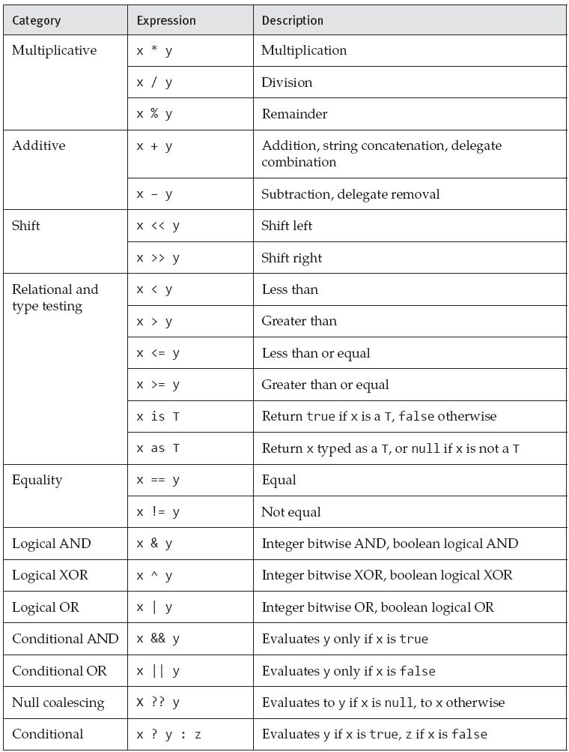
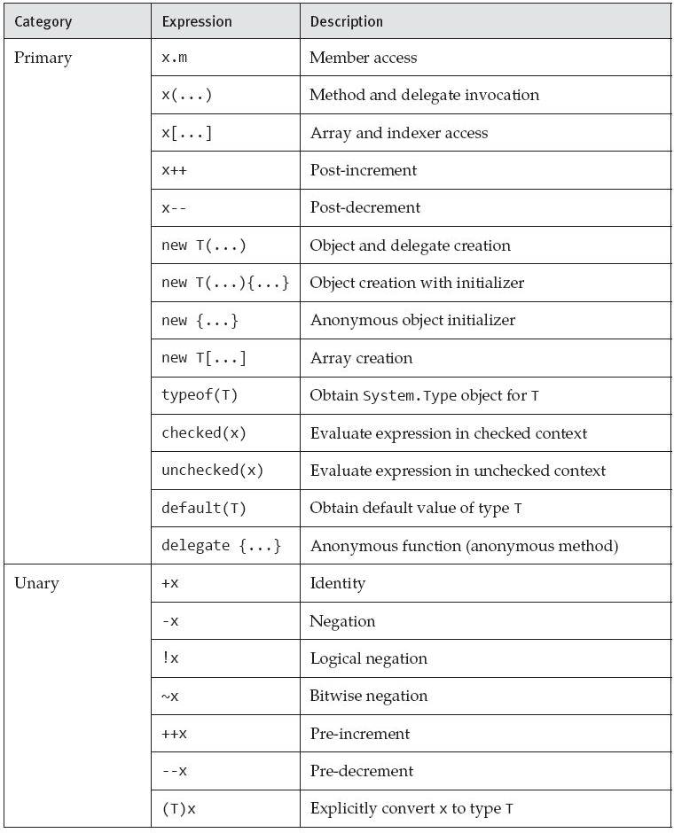
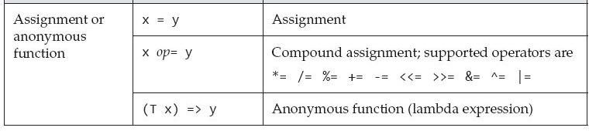
Expressions in C#
http://msdn.microsoft.com/en-us/library/ms173144.aspx

Slide 33
Expressions in C# Conversions
int a = 123;
long b = a; // Implicit conversion from int to long
int c = (int) b; // Explicit conversion from long to int

Slide 34
Expressions in C# this and base operator
this
Value is a reference to the object for which the method or accessor was invoked
base
Used to access base class members

Slide 35
Expressions in C# The new operator
Object creation expressions are used to create new instances of class types and value types
Array creation expressions are used to create new instances of array types
Delegate creation expressions are used to create new instances of delegate types

Slide 36
Expressions in C# The new operator
public class Point
{
public int X { get; set; }
public int Y { get; set; }
}
[…]
Point a = new Point { X = 0, Y = 1 };
Object initializers
public class Rectangle
{
Point p1 = new Point();
Point p2 = new Point();
public Point P1 { get { return p1; } }
public Point P2 { get { return p2; } }
}
[…]
Rectangle r = new Rectangle {
P1 = { X = 0, Y = 1 },
P2 = { X = 2, Y = 3 }
};

Slide 37
Expressions in C# The new operator
public class Contact
{
string name;
List<string> phoneNumbers = new List<string>();
public string Name { get { return name; } set { name = value; } }
public List<string> PhoneNumbers { get { return phoneNumbers; } }
}
Collection initializers
List<int> digits = new List<int> { 0, 1, 2, 3, 4, 5, 6, 7, 8, 9 };
var contacts = new List<Contact> {
new Contact {
Name = "Chris Smith",
PhoneNumbers = { "206-555-0101", "425-882-8080" }
},
new Contact {
Name = "Bob Harris",
PhoneNumbers = { "650-555-0199" }
}
};

Slide 38
Expressions in C# The new operator
var x = new int[,] {{0, 1}, {2, 3}, {4, 5}};
[…]
int[][] a = new int[100][];
for (int i = 0; i < 100; i++) a[i] = new int[5];
[…]
var a = new[] { 1, 10, 100, 1000 }; // int[]
var b = new[] { 1, 1.5, 2, 2.5 }; // double[]
var c = new[,] { { "hello", null }, { "world", "!" } }; // string[,]
var d = new[] { 1, "one", 2, "two" }; // Error
[…]
Array creation expressions

Slide 39
Expressions in C# The new operator
var contacts = new[] {
new {
Name = "Chris Smith",
PhoneNumbers = new[] { "206-555-0101", "425-882-8080" }
},
new {
Name = "Bob Harris",
PhoneNumbers = new[] { "650-555-0199" }
}
};
Anonymously typed data structures

Slide 40
Expressions in C# The new operator
delegate double DoubleFunc(double x);
class A
{
// refers to the second Square method because that method
// exactly matches the formal parameter list and return type of DoubleFunc
DoubleFunc f = new DoubleFunc(Square);
static float Square(float x) {
return x * x;
}
static double Square(double x) {
return x * x;
}
}
Delegate Creation Expressions

Slide 41
Statements
C# Introduction
http://msdn.microsoft.com/en-us/library/ms173143.aspx

Slide 42
Statements in C# Delaration of Variables and Constants
Local variable declaration:
static void Main() {
int a;
int b = 2, c = 3;
a = 1;
Console.WriteLine(a + b + c);
}
Local constant declaration:
static void Main() {
const float pi = 3.1415927f;
const int r = 25;
Console.WriteLine(pi * r * r);
}

Slide 43
Statements in C# „if“ and „switch“ Statement
„if“ Statement:
static void Main(string[] args) {
if (args.Length == 0) {
Console.WriteLine("No arguments");
}
else {
Console.WriteLine("One or more arguments");
}
}
„switch“ Statement:
static void Main(string[] args) {
int n = args.Length;
switch (n) {
case 0:
Console.WriteLine("No arguments");
break;
case 1:
Console.WriteLine("One argument");
break;
default:
Console.WriteLine("{0} arguments", n);
break;
}
}
}

Slide 44
Statements in C# „while“ and „do“ Statement
„while“ Statement:
static void Main(string[] args) {
int i = 0;
while (i < args.Length) {
Console.WriteLine(args[i]);
i++;
}
}
„do“ Statement:
static void Main() {
string s;
do {
s = Console.ReadLine();
if (s != null) Console.WriteLine(s);
} while (s != null);
}

Slide 45
Statements in C# „for“ and „foreach“ Statement
„for“ Statement:
static void Main(string[] args) {
for (int i = 0; i < args.Length; i++) {
Console.WriteLine(args[i]);
}
}
„foreach“ Statement:
static void Main(string[] args) {
foreach (string s in args) {
Console.WriteLine(s);
}
}

Slide 46
Statements in C# „break“ and „continue“ Statement
„break“ Statement:
static void Main() {
while (true) {
string s = Console.ReadLine();
if (s == null) break;
Console.WriteLine(s);
}
}
„continue“ Statement:
static void Main(string[] args) {
for (int i = 0; i < args.Length; i++) {
if (args[i].StartsWith("/")) continue;
Console.WriteLine(args[i]);
}
}

Slide 47
Statements in C# „return“ and „goto“ Statement
„return“ Statement:
static int Add(int a, int b) {
return a + b;
}
static void Main() {
Console.WriteLine(Add(1, 2));
return;
}
„goto“ Statement:
// we do not use goto ;-)

Slide 48
Statements in C# „yield“ Statement
The yield statement is used
to yield a value to an enumerator/enumerable object or
to signal the end of the iteration
yield return …;
yield break …;
Execution of the iterator block is suspended

Slide 49
Statements in C# „yield“ Statement
static IEnumerable<int> Range(int from, int to) {
for (int i = from; i < to; i++) {
yield return i;
}
yield break;
}
static void Main() {
foreach (int x in Range(-10,10)) {
Console.WriteLine(x);
}
}

Slide 50
Statements in C# „yield“ Statement
using System;
using System.Collections;
using System.Collections.Generic;
class Stack<T>: IEnumerable<T>
{
T[] items;
int count;
public void Push(T item) {
if (items == null) {
items = new T[4];
}
else if (items.Length == count) {
T[] newItems = new T[count * 2];
Array.Copy(items, 0, newItems, 0, count);
items = newItems;
}
items[count++] = item;
}
public T Pop() {
T result = items[--count];
items[count] = default(T);
return result;
}
public IEnumerator<T> GetEnumerator() {
for (int i = count - 1; i >= 0; --i) yield return items[i];
}
}

Slide 51
Statements in C# „throw/try“ Statement
static double Divide(double x, double y) {
if (y == 0) throw new DivideByZeroException();
return x / y;
}
static void Main(string[] args) {
try {
if (args.Length != 2) {
throw new Exception("Two numbers required");
}
double x = double.Parse(args[0]);
double y = double.Parse(args[1]);
Console.WriteLine(Divide(x, y));
}
catch (Exception e) {
Console.WriteLine(e.Message);
}
finally {
Console.WriteLine("Good bye!");
}
}

Slide 52
Statements in C# „checked“ and „unchecked“ Statement
static void Main() {
int i = int.MaxValue;
checked {
Console.WriteLine(i + 1); // Exception
}
unchecked {
Console.WriteLine(i + 1); // Overflow
}
}

Slide 53
Statements in C# „lock“ Statement
class Account
{
decimal balance;
public void Withdraw(decimal amount) {
lock (this) {
if (amount > balance) {
throw new Exception("Insufficient funds");
}
balance -= amount;
}
}
}

Slide 54
Statements in C# „using“ Statement
static void Main() {
using (TextWriter w = File.CreateText("test.txt")) {
w.WriteLine("Line one");
w.WriteLine("Line two");
w.WriteLine("Line three");
}
}
Tip: IDisposable pattern!

Slide 55
Classes and Objects
C# Introduction
http://msdn.microsoft.com/en-us/library/ms173109.aspx

Slide 56
Classes and Objects
public class Point
{
public int x, y;
public Point(int x, int y) {
this.x = x;
this.y = y;
}
}
[…]
Point p1 = new Point(0, 0);
Point p2 = new Point(10, 20);

Slide 57
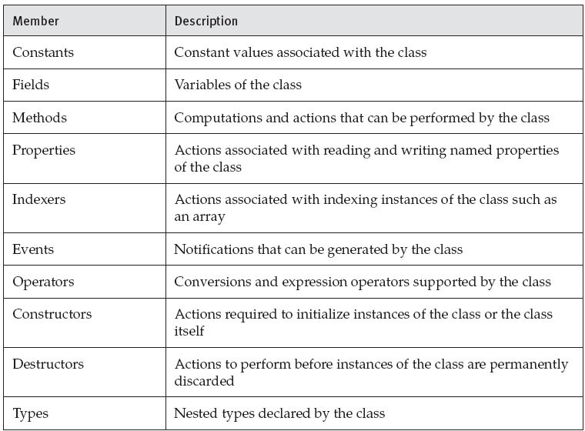
Classes Members of Classes

Slide 58
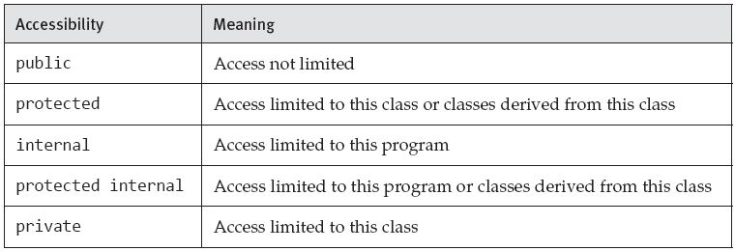
Classes Accessibility

Slide 59
Classes Generic Classes
public class Pair<TFirst,TSecond>
{
public TFirst First;
public TSecond Second;
}
[…]
Pair<int,string> pair = new Pair<int,string> { First = 1, Second = "two" };
int i = pair.First; // TFirst is int
string s = pair.Second; // TSecond is string
http://msdn.microsoft.com/en-us/library/512aeb7t.aspx

Slide 60
Classes Base Classes
public class Point
{
public int x, y;
public Point(int x, int y) {
this.x = x;
this.y = y;
}
}
public class Point3D: Point
{
public int z;
public Point3D(int x, int y, int z): base(x, y) {
this.z = z;
}
}

Slide 61
Classes Base Classes
class Base
{
public static void F() {}
}
class Derived: Base
{
new private static void F() {} // Hides Base.F in Derived only
}
class MoreDerived: Derived
{
static void G() { F(); } // Invokes Base.F
}
Hiding through inheritance

Slide 62
Classes Sealed Classes
sealed modifier
Used to prevent derivation from a class
Compile-time error occurs if a sealed class is specified as the base class of another class

Slide 63
Classes Static Classes
static modifier
Cannot be instantiated
Cannot be used as a type
Can contain only static members

Slide 64
Classes Partial Classes
partial modifier
Multiple partial type declarations with the same name within an enclosing namespace or type declaration combine to form one type declaration
Used for…
…splitting classes across multiple files
…code generation

Slide 65
Classes Fields
public class Color
{
public static readonly Color Black = new Color(0, 0, 0);
public static readonly Color White = new Color(255, 255, 255);
public static readonly Color Red = new Color(255, 0, 0);
public static readonly Color Green = new Color(0, 255, 0);
public static readonly Color Blue = new Color(0, 0, 255);
private byte r, g, b;
public Color(byte r, byte g, byte b) {
this.r = r;
this.g = g;
this.b = b;
}
}
Note difference between fields and instance fields (static)

Slide 66
Classes – Methods
Static methods vs. instace methods
Method name
(Optional) List of parameters
(Optional) Return type
void if no return type
(Optional) Type parameters
Similar to generic types
Signature of a method
Name + number of type parameters + number, modifier and types of parameters
Must be unique inside the class

Slide 67
Classes – Methods Parameters
Reference parameters:
using System;
class Test
{
static void Swap(ref int x, ref int y) {
int temp = x;
x = y;
y = temp;
}
static void Main() {
int i = 1, j = 2;
Swap(ref i, ref j);
Console.WriteLine("{0} {1}", i, j); // Outputs "2 1"
}
}
Tip: Reference types are allways passed by reference!

Slide 68
Classes – Methods Parameters
Output parameters:
using System;
class Test
{
static void Divide(int x, int y, out int result, out int remainder) {
result = x / y;
remainder = x % y;
}
static void Main() {
int res, rem;
Divide(10, 3, out res, out rem);
Console.WriteLine("{0} {1}", res, rem); // Outputs "3 1"
}
}

Slide 69
Classes – Methods Parameters
Parameter array:
public class Console
{
public static void Write(string fmt, params object[] args) {...}
public static void WriteLine(string fmt, params object[] args) {...}
...
}
[…]
Console.WriteLine("x={0} y={1} z={2}", x, y, z);
[…]
// same output as above!
string s = "x={0} y={1} z={2}";
object[] args = new object[3];
args[0] = x;
args[1] = y;
args[2] = z;
Console.WriteLine(s, args);
Variable number of parameters

Slide 70
Classes – Methods Static vs. Instance Methods
class Entity
{
static int nextSerialNo;
int serialNo;
public Entity() {
serialNo = nextSerialNo++;
}
public int GetSerialNo() {
return serialNo;
}
public static int GetNextSerialNo() {
return nextSerialNo;
}
public static void SetNextSerialNo(int value) {
nextSerialNo = value;
}
}

Slide 71
Classes – Methods virtual, override and abstract
Virtual
The runtime type of the instance for which that invocation takes place determines the actual method implementation to invoke
Can be overridden (override) in a derived class
Nonvirtual
The compile-time type of the instance is the determining factor
Abstract
Virtual method with no implementation
Only in a class that is also declared abstract
Must be overridden in every non-abstract derived class

Slide 72
Classes – Methods virtual, override and abstract
[…]
double GetHourlyRate(Person p) {
if( p is Student ) { return 1.0; }
else if( p is Employee ) { return 10.0; }
return 0.0;
}
[…]
abstract class Person { public virtual double GetHourlyRate() { return 0.0; } }
class Student : Person { public override double GetHourlyRate() { return 1.0; } }
class Employee : Person { public override double GetHourlyRate() { return 10.0; } }

Slide 73
Classes – Methods Method overloading
class Test
{
static void F() {
Console.WriteLine("F()");
}
static void F(object x) {
Console.WriteLine("F(object)");
}
static void F(int x) {
Console.WriteLine("F(int)");
}
static void F(double x) {
Console.WriteLine("F(double)");
}
static void F<T>(T x) {
Console.WriteLine("F<T>(T)");
}
static void F(double x, double y) {
Console.WriteLine("F(double, double)");
}
static void Main() {
F(); // Invokes F()
F(1); // Invokes F(int)
F(1.0); // Invokes F(double)
F("abc"); // Invokes F(object)
F((double)1); // Invokes F(double)
F((object)1); // Invokes F(object)
F<int>(1); // Invokes F<T>(T)
F(1, 1); // Invokes F(double, double)
}
}

Slide 74
Classes Constructors
Instance constructor
Actions required to initialize an instance of a class
Method with no return type and the same name as the containing class
If no instance constructor is supplied, an empty one with no parameters is provided automatically
Static constructor
Actions required to initialize a class itself when it is first loaded
Like instance constructur, with modifer static

Slide 75
Classes Constructors
public class List<T>
{
public List(): this(defaultCapacity) {}
public List(int capacity) { items = new T[capacity]; }
[…]
}
Tip: Use base(…) to call a base class‘ constructor

Slide 76
Classes Properties
Similar to fields
Properties do not denote storage locations
Properties have accessors that specify the statements to be executed when their values are read or written
get/set
get: parameterless method with a return value of the property type
set: method with a single parameter named value and no return type
Accessibility
read-write property (get and set)
read-only property (only get)
write-only property (only set)

Slide 77
Classes Properties
public class List<T> {
[…]
public int Count {
get { return count; }
}
public int Capacity {
get {
return items.Length;
}
set {
if (value < count) value = count;
if (value != items.Length) {
T[] newItems = new T[value];
Array.Copy(items, 0, newItems, 0, count);
items = newItems;
}
}
}
[…]
}

Slide 78
Classes Auto-implemented Properties
public class Point {
public int X { get; set; } // Automatically implemented
public int Y { get; set; } // Automatically implemented
}
// equivalent to
public class Point2 {
private int x;
private int y;
public int X { get { return x; } set { x = value; } }
public int Y { get { return y; } set { y = value; } }
}
[…]
public class ReadOnlyPoint {
public int X { get; private set; }
public int Y { get; private set; }
public ReadOnlyPoint(int x, int y) { X = x; Y = y; }
}

Slide 79
Classes Indexers
public class List<T> {
[…]
public T this[int index] {
get {
return items[index];
}
set {
items[index] = value;
OnChanged();
}
}
[…]
}

Slide 80
Classes Events
Enables a class or object to provide notifications
Declared in the same ways as a field, except…
declaration includes an event keyword and
the type must be a delegate type
Event handlers
Attached using the += operator
Removed using the -= operator

Slide 81
Classes Events
public class List<T> {
[…]
public event EventHandler Changed;
[…]
public void Add(T item) {
if (count == Capacity) Capacity = count * 2;
items[count] = item;
count++;
OnChanged();
}
protected virtual void OnChanged() {
if (Changed != null)
Changed(this, EventArgs.Empty);
}
[…]
}
using System;
class Test
{
static int changeCount;
static void ListChanged(object sender, EventArgs e) {
changeCount++;
}
static void Main() {
List<string> names = new List<string>();
names.Changed += new EventHandler(ListChanged);
names.Add("Liz");
names.Add("Martha");
names.Add("Beth");
Console.WriteLine(changeCount); // Outputs "3"
}
}
Event handling
Event declaration

Slide 82
Classes Operators
Defines the meaning of applying a particular expression operator to instances of a class
unary operators
binary operators
conversion operators

Slide 83
Classes Operators
public class List<T> {
[…]
public static bool operator ==(List<T> a, List<T> b) {
return Equals(a, b);
}
public static bool operator !=(List<T> a, List<T> b) {
return !Equals(a, b);
}
[…]
}
Binary operator

Slide 84
Classes Operators
public class IntVector
{
public IntVector(int length) {...}
public int Length {...} // Read-only property
public int this[int index] {...} // Read-write indexer
public static IntVector operator ++(IntVector iv) {
IntVector temp = new IntVector(iv.Length);
for (int i = 0; i < iv.Length; i++)
temp[i] = iv[i] + 1;
return temp;
}
}
Unary operator

Slide 85
Classes Destructors
Use destructors only together with IDisposable-pattern (using statement)
See MSDN for details
http://msdn.microsoft.com/en-us/library/fs2xkftw.aspx
http://msdn.microsoft.com/en-us/library/66x5fx1b.aspx

Slide 86
Structs
C# Introduction

Slide 87
Structs
Structs are value types
Directly stores the data of the struct
Struct types do not support user-specified inheritance
All struct types implicitly inherit from type object
Used for small data structures
http://msdn.microsoft.com/en-us/library/saxz13w4.aspx

Slide 88
Structs
struct Point
{
public int x, y;
public Point(int x, int y) {
this.x = x;
this.y = y;
}
}
[…]
// Output on whether Point is a class or a struct
Point a = new Point(10, 10);
Point b = a;
a.x = 20;
Console.WriteLine(b.x);

Slide 89
Arrays
C# Introduction

Slide 90
Arrays
Contains a number of variables that are accessed through computed indices
Array types are reference types
Indices of the elements of an array range from 0 to Length – 1
new operator automatically initializes the elements of an array to their default value
http://msdn.microsoft.com/en-us/library/9b9dty7d.aspx

Slide 91
Arrays
using System;
class Test
{
static void Main() {
int[] a = new int[10];
for (int i = 0; i < a.Length; i++) {
a[i] = i * i;
}
for (int i = 0; i < a.Length; i++) {
Console.WriteLine("a[{0}] = {1}", i, a[i]);
}
}
}

Slide 92
Arrays Multi-dimensional and Jagged Arrays
Multi-dimensional array:
int[] a1 = new int[10];
int[,] a2 = new int[10, 5];
int[,,] a3 = new int[10, 5, 2];
Jagged array:
int[][] a = new int[3][];
a[0] = new int[10];
a[1] = new int[5];
a[2] = new int[20];

Slide 93
Arrays Array Initializers
int[] a = new int[] {1, 2, 3};
// …is the same as
int[] a = {1, 2, 3};
// …is the same as
int[] t = new int[3];
t[0] = 1;
t[1] = 2;
t[2] = 3;
int[] a = t;

Slide 94
Interfaces
C# Introduction

Slide 95
Interfaces
Contract that can be implemented by classes and structs
Can contain methods, properties, events, and indexers
Does not provide implementations of the members
Interfaces may employ multiple inheritance
http://msdn.microsoft.com/en-us/library/ms173156.aspx

Slide 96
Interfaces
interface IControl
{
void Paint();
}
interface ITextBox: IControl
{
void SetText(string text);
}
interface IListBox: IControl
{
void SetItems(string[] items);
}
interface IComboBox: ITextBox, IListBox {}
interface IDataBound
{
void Bind(Binder b);
}
public class EditBox: IControl, IDataBound
{
public void Paint() {...}
public void Bind(Binder b) {...}
}
EditBox editBox = new EditBox();
IControl control = editBox;
IDataBound dataBound = editBox;
// …or
object obj = new EditBox();
IControl control = (IControl)obj;
IDataBound dataBound = (IDataBound)obj;

Slide 97
Enumerations
C# Introduction

Slide 98
Enumerations
Distinct value type with a set of named constants
Each enum type has a corresponding integral type called the underlying type
Default: int
http://msdn.microsoft.com/en-us/library/cc138362.aspx

Slide 99
Enumerations
using System;
enum Color
{
Red,
Green,
Blue
}
class Test
{
static void PrintColor(Color color) {
switch (color) {
case Color.Red:
Console.WriteLine("Red");
break;
case Color.Green:
Console.WriteLine("Green");
break;
case Color.Blue:
Console.WriteLine("Blue");
break;
default:
Console.WriteLine("Unknown color");
break;
}
}
static void Main() {
Color c = Color.Red;
PrintColor(c);
PrintColor(Color.Blue);
}
}

Slide 100
Delegates
C# Introduction

Slide 101
Delegates
References to methods with a particular parameter list and return type
Similar to function pointers, but…
…object-oriented and
type-safe
http://msdn.microsoft.com/en-us/library/ms173171.aspx

Slide 102
Delegates
using System;
delegate double Function(double x);
class Multiplier
{
double factor;
public Multiplier(double factor) {
this.factor = factor;
}
public double Multiply(double x) {
return x * factor;
}
}
class Test
{
static double Square(double x) {
return x * x;
}
static double[] Apply(double[] a, Function f) {
double[] result = new double[a.Length];
for (int i = 0; i < a.Length; i++) result[i] = f(a[i]);
return result;
}
static void Main() {
double[] a = {0.0, 0.5, 1.0};
double[] squares = Apply(a, Square);
double[] sines = Apply(a, Math.Sin);
Multiplier m = new Multiplier(2.0);
double[] doubles = Apply(a, m.Multiply);
}
}

Slide 103
Delegates Anonymous Functions
[…]
double[] doubles = Apply(a, (double x) => x * 2.0);
[…]

Slide 104
Attributes
C# Introduction

Slide 105
Attributes
User-defined types of declarative information
Retrieved at runtime (Reflection)
http://msdn.microsoft.com/en-us/library/z0w1kczw.aspx

Slide 106
Attributes
[Help("http://msdn.microsoft.com/.../MyClass.htm")]
public class Widget
{
[Help("http://msdn.microsoft.com/.../MyClass.htm", Topic = "Display")]
public void Display(string text) {}
}
using System;
public class HelpAttribute: Attribute
{
string url;
string topic;
public HelpAttribute(string url) {
this.url = url;
}
public string Url {
get { return url; }
}
public string Topic {
get { return topic; }
set { topic = value; }
}
}
using System;
using System.Reflection;
class Test
{
static void ShowHelp(MemberInfo member) {
HelpAttribute a = Attribute.GetCustomAttribute(member,
typeof(HelpAttribute)) as HelpAttribute;
if (a == null) {
Console.WriteLine("No help for {0}", member);
}
else {
Console.WriteLine("Help for {0}:", member);
Console.WriteLine(" Url={0}, Topic={1}", a.Url, a.Topic);
}
}
static void Main() {
ShowHelp(typeof(Widget));
ShowHelp(typeof(Widget).GetMethod("Display"));
}
}

Slide 107
Documentation Comments
C# Introduction

Slide 108
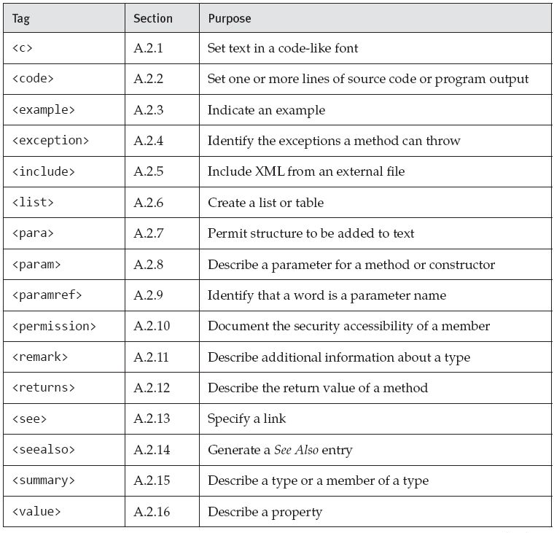

Documentation Comments

Slide 109
Documentation Comments
/// <summary>This method changes the point's location by
/// the given x- and y-offsets.
/// <example>For example:
/// <code>
/// Point p = new Point(3,5);
/// p.Translate(-1,3);
/// </code>
/// results in <c>p</c>'s having the value (2,8).
/// </example>
/// </summary>
public void Translate(int xor, int yor) {
X += xor;
Y += yor;
}
Tip: Use project Sandcastle to generate documentation

